Slide 1
Developing and Analyzing the Atlanta Police Dept.’s DBMS
December 5, 2016
Xin Xiong

Slide 2
Overview
Introduction
Entities and ER Diagram
Context Diagram
Level 0 Data Flow Diagram
Physical Tables and Sample Data Entry
Queries and Results

Slide 3
Important Entities
OffenseID
OffenseTime
VictimID
……
Offense Type
Victim
Offense
Location
Suspect
Police Officer

Slide 4
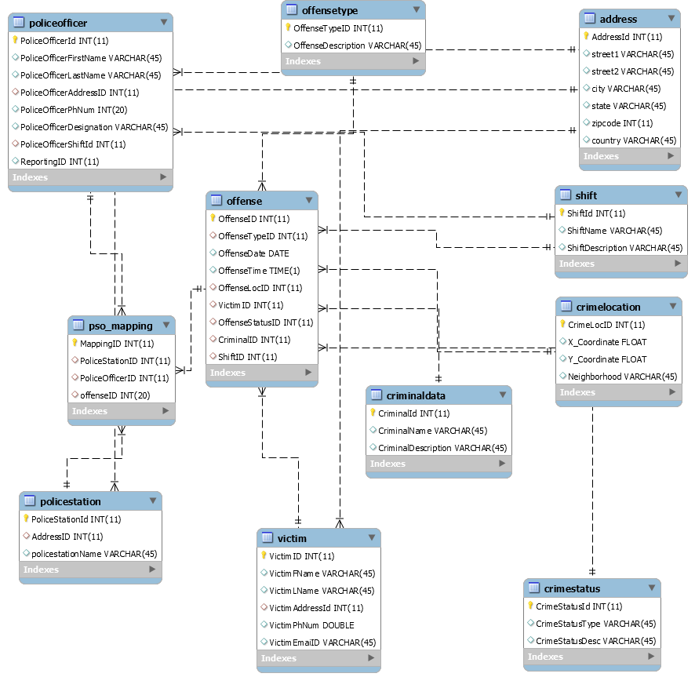
ER Diagram

Slide 5
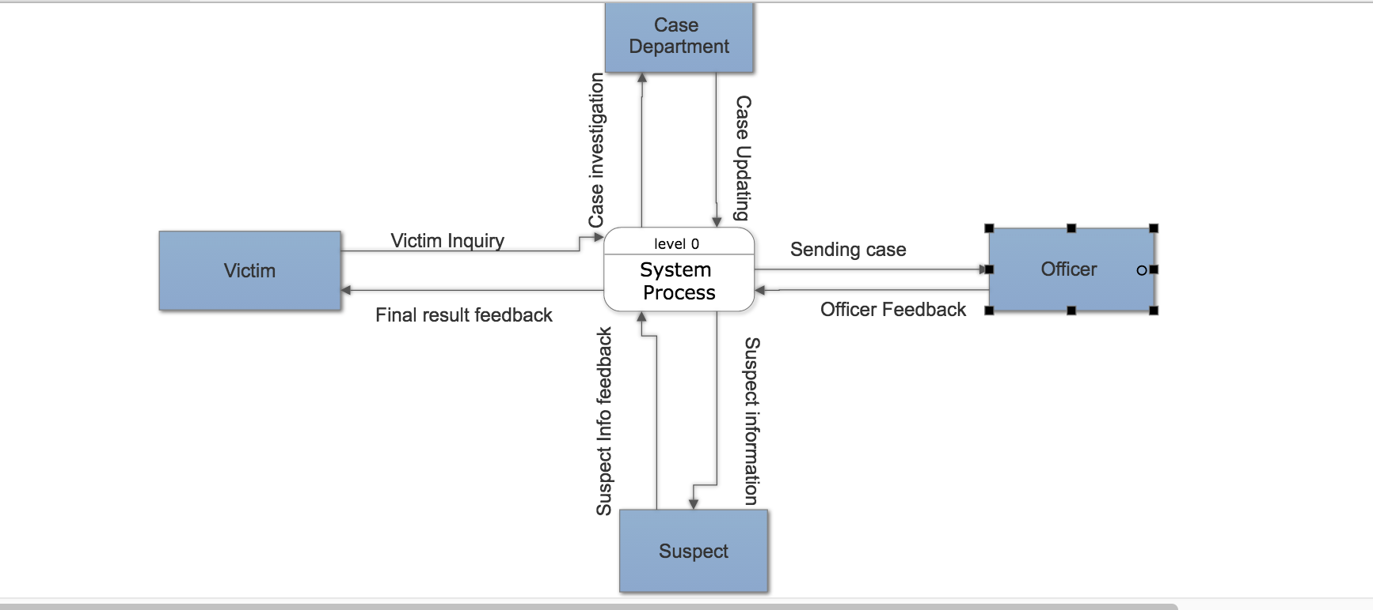
Context Diagram

Slide 6
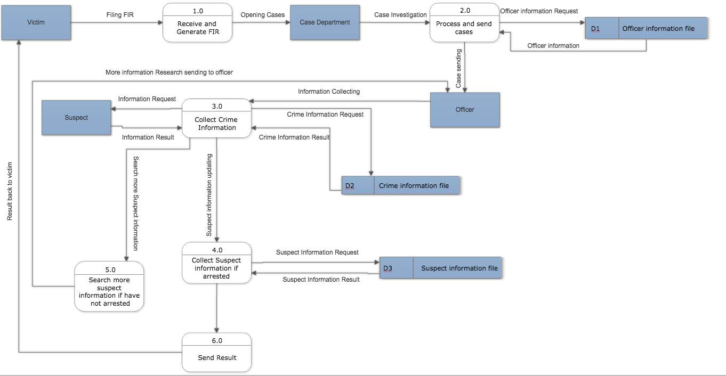
Level 1 Data Flow Diagram

Slide 7
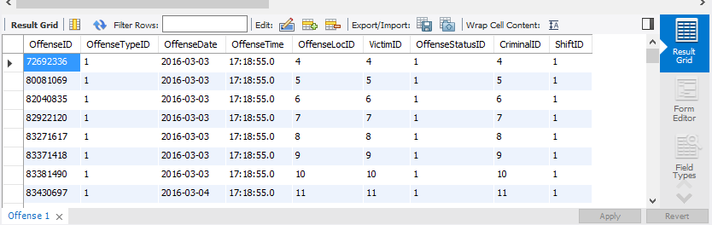
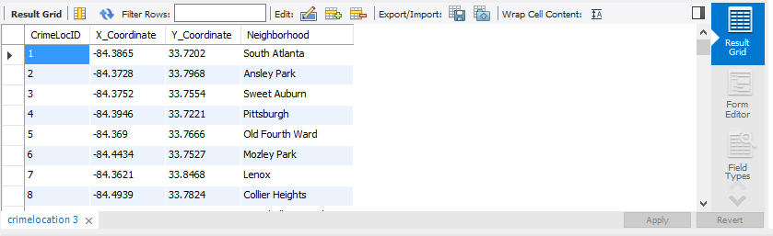
Physical Tables and Sample Data Entry

Slide 8
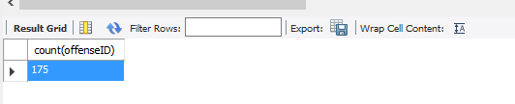
Queries and Results
Total active crimes in Atlanta.
select count(offenseID) from databaseproject.offense as a, databaseproject.crimestatus as b
where a.OffenseStatusID = b.CrimeStatusId and b.CrimeStatusType = 'A'

Slide 9
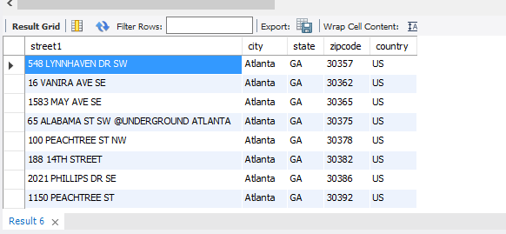
Queries and Results
Finding the address of the victim whose crime status is not complete but whose file is still closed.
select a.street1,a.city,a.state,a.zipcode,a.country from databaseproject.address a ,
databaseproject.victim b,databaseproject.offense c,databaseproject.crimestatus d
where a.AddressId = b.VictimAddressId
and c.VictimID = b.VictimID
and c.OffenseStatusID = d.CrimeStatusId
and d.CrimeStatusType = 'CI'
Total 8 Rows Returned as Output

Slide 10
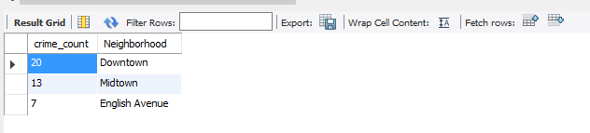
Queries and Results
Top 3 neighborhoods in crime.
select count(OffenseID) as cnt, Neighborhood from
(select A.* , B.* from databaseproject.crimelocation as A, databaseproject.offense as B
where A.CrimeLocID = B.OffenseLocID) as T1
group by Neighborhood
order by cnt DESC
LIMIT 3

Slide 11
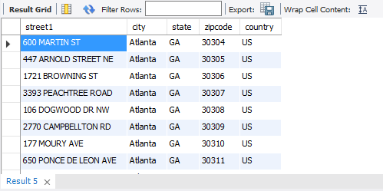
Queries and Results
Finding the address of the victim whose crime status is active.
select a.street1,a.city,a.state,a.zipcode,a.country from databaseproject.address a ,
databaseproject.victim b,databaseproject.offense c,databaseproject.crimestatus d
where a.AddressId = b.VictimAddressId
and c.VictimID = b.VictimID
and c.OffenseStatusID = d.CrimeStatusId
and d.CrimeStatusType = 'A';
Total 175 rows Returned –

Slide 12
Questions & Discussion

Slide 14
Back-up Slides

Slide 15
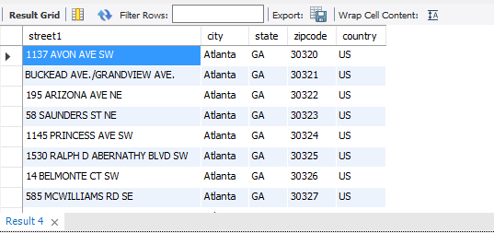
Queries and Results
Finding the address of the victim whose crime status is completed and whose file is closed.
select a.street1,a.city,a.state,a.zipcode,a.country from databaseproject.address a ,
databaseproject.victim b,databaseproject.offense c,databaseproject.crimestatus d
where a.AddressId = b.VictimAddressId
and c.VictimID = b.VictimID
and c.OffenseStatusID = d.CrimeStatusId
and d.CrimeStatusType = 'CC';
Total – 13 Rows Returned as Output

Slide 16
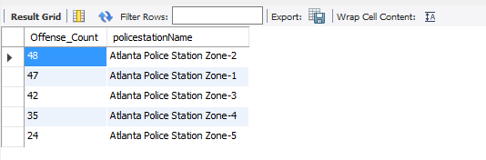
Queries and Results
Count of number of crimes reported per police station in Atlanta.
select count(OffenseID) as cnt, policestationName from
(select B.OffenseID,policestationName from databaseproject.policestation as A,databaseproject.offense as B,databaseproject.pso_mapping as C
where A.PoliceStationId = C.PoliceStationID and C.offenseID = B.OffenseID
) as T1
group by policestationName
order by cnt DESC;

Slide 17

Queries and Results
Top 3 police officers dealing with most offenses.
select policeofficer.PoliceOfficerFirstName, policeofficer.PoliceOfficerLastName, count(pso_mapping.offenseID)
from pso_mapping, policeofficer
where pso_mapping.PoliceOfficerID = policeofficer.PoliceOfficerId
group by pso_mapping.PoliceofficerID
order by (select count(pso_mapping.offenseID)) desc;

Slide 18
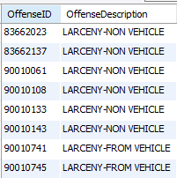
Queries and Results
Get all the offense after 2016-04-15 with their descriptions.
select offense.OffenseID, offensetype.OffenseDescription
from offensetype, offense
where offense.OffenseDate > 2016-04-15 and
offense.OffenseTypeID = offensetype.OffenseTypeID;

Slide 19

Queries and Results
Calculate the number of offenses which happen during daytime (we had three shift: day, evening, night).
select count(offense.offenseid)
from offense, shift
where offense.ShiftID in
(select shift.shiftid
from shift
where shift.ShiftName = "Day");

Slide 20
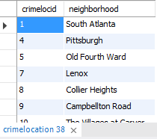
Queries and Results
List the neighborhoods where at least two crimes took place, ordered by locationID.
select crimelocation.crimelocid, crimelocation.neighborhood
from crimelocation
group by crimelocation.neighborhood
having count(crimelocation.crimelocid) > 1
order by crimelocation.crimelocid;

